Slide 1
Introduction to Python
Presented by Abeer Rahman
Aug-21-2024

Slide 2
Agenda
Introduction
Installing Python
Your first line of code
Programming concepts & Hands-on exercises
Wrap-up & Resources

Slide 3
Audience
Notes:
Poll – show of hands -
Who has experience in writing code?
What language have you used?

Slide 4
Programming Languages
Computer instructions are natively in 1s and 0s which are not easy to write (by humans)
A programming language is a formal language comprising a set of computer instructions that produce various kinds of output
Programmers use programming languages to write code that can be executed by computers to perform specific tasks
Usually easily more comprehendible as these are in English
Notes:
A programming language is a formal language comprising a set of instructions that produce various kinds of output. Programmers use programming languages to write code that can be executed by computers to perform specific tasks.

Slide 5
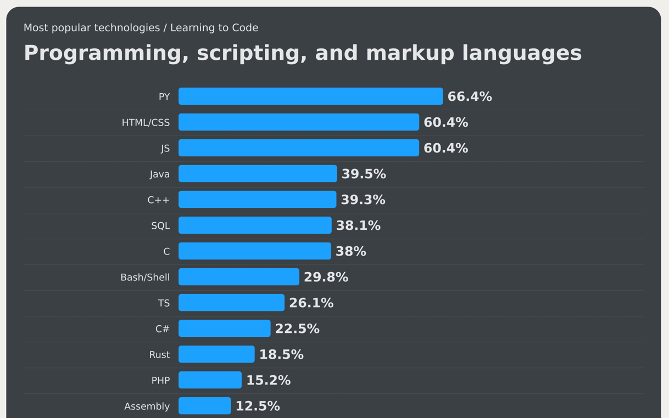

Popular Programming Languages (for those learning to code)
There are many programming languages, each with its own syntax, semantics, and use cases. Some popular programming languages include:
Python: Known for its readability and versatility
JavaScript: Widely used for web development.
Java: Commonly used in large companies and Android app development.
C++: Often used in system/software development (like phones) and game programming.
Notes:
Questions -
Anyone here written code in Assembly?

Slide 6
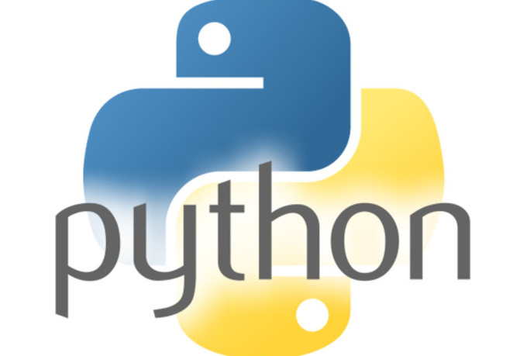
Python
Python is a high-level, general-purpose programming language known for its readability and simplicity.
First released in 1991.
Fun fact - the language is named after the BBC show “Monty Python’s Flying Circus” and has nothing to do with reptiles!

Slide 7

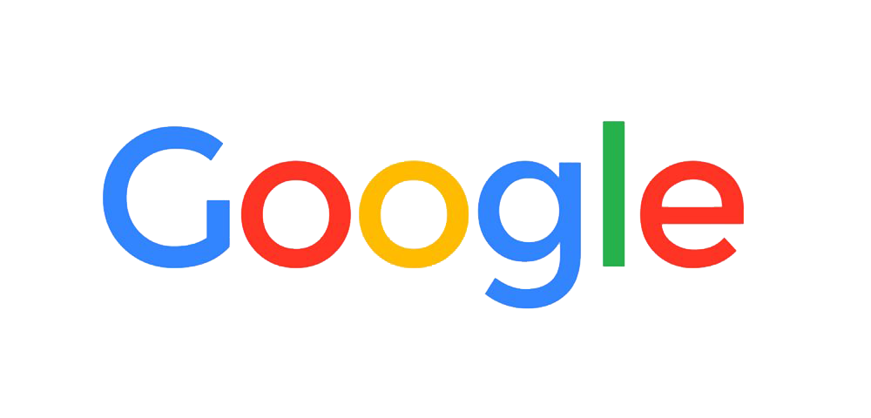
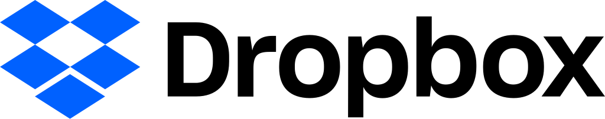
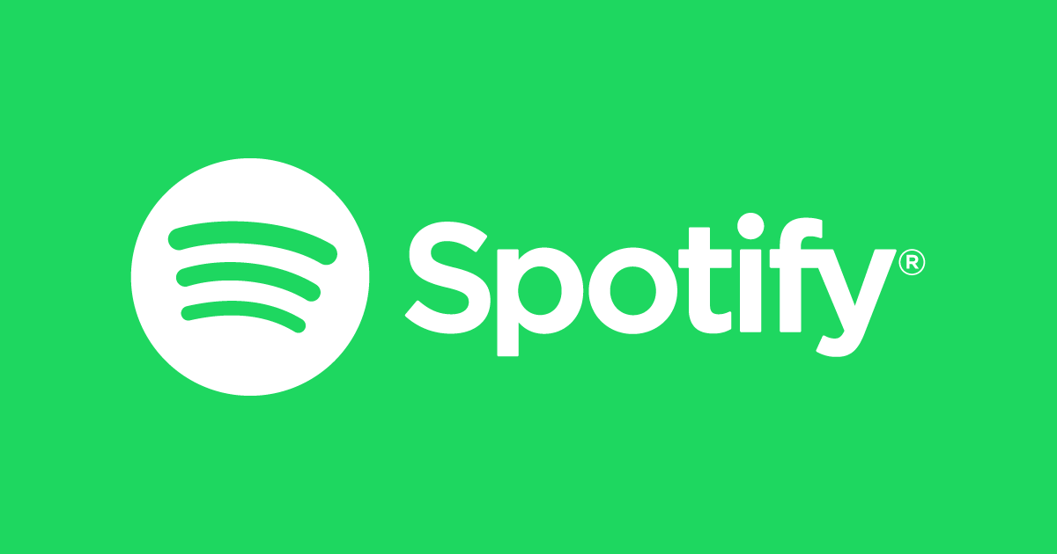
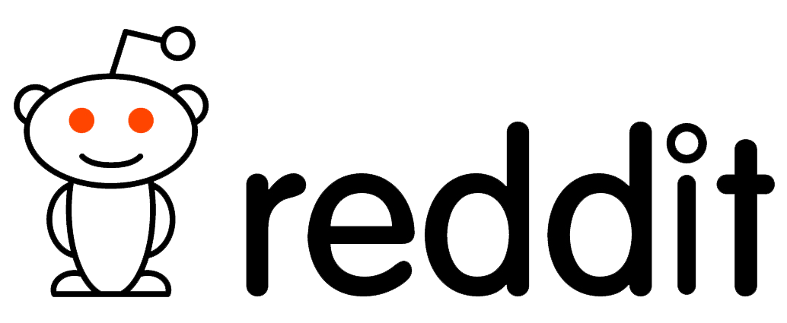
Python in the wild
Note: these companies use other languages too! (right tool for the right job)
Notes:
Instagram: Relies on Python for its backend infrastructure2.
Dropbox: Uses Python for its desktop client and server-side code1.
Google: Uses Python for many of its internal systems and APIs1.
Reddit: Built using Python and continues to use it for various functionalities2.
Spotify: Employs Python for backend services and data analysis2.
These companies leverage Python for its simplicity, versatility, and extensive libraries, making it a popular choice for a wide range of applications.

Slide 8
Why Python
One of the most popular programming languages, and has gained widespread use in the machine learning community
Ease of learning
Versatility
Extensive libraries
Community support
Cross-platform
Notes:
Ease of Learning: Python’s syntax is clear and easy to understand, making it a great choice for beginners.
Versatility: Python can be used for a wide range of applications, including web development, data analysis, artificial intelligence, scientific computing, and more1.
Extensive Libraries: Python has a rich ecosystem of libraries and frameworks, such as Django for web development, NumPy and pandas for data analysis, and TensorFlow for machine learning2.
Community Support: Python has a large and active community, which means you can find plenty of resources, tutorials, and forums to help you learn and troubleshoot1.
Cross-Platform: Python is cross-platform, meaning it can run on various operating systems like Windows, macOS, and Linux

Slide 9
Getting started: Setting up Python

Slide 10
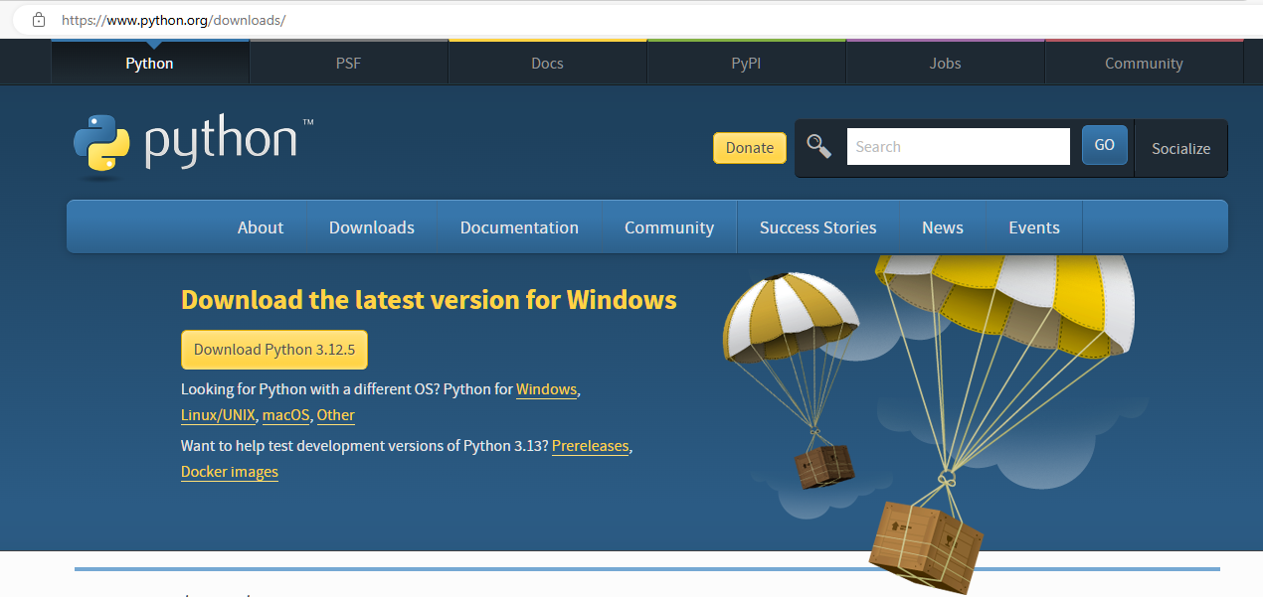
Download & Install
https://www.python.org/downloads/

Slide 11
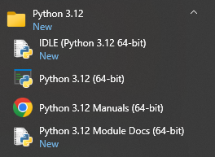
Navigate to: Start menu > Python

Slide 12
Hands-on!
We will go over concepts and code exercises in the next section
Notes:
Using the interpreter and the command line.
Run example 01.py

Slide 13
Your first line of code in Python!

Slide 14
Concept 1: Variables
Variables are a way to store values
For example, if you want to store day of the week, here’s a simple way to think about it – imagine variable as a box.
Variable Name: The label on the box (e.g., DAY).
Value: The content inside the box (e.g., "Wednesday").
Notes:
Think of a variable as a “container” or “box” that holds information. Just like you might have a box labeled “Toys” to store your toys, in programming, a variable is given a name and is used to store data.

Slide 15
Concept 1: Variables
Code exercise: use variable to show day of week
Notes:
Additional examples:

Slide 16
Concept 2: User input
"Input” refers to getting information from the user.
It’s like asking someone a question and waiting for their answer.
“What’s your favorite color?”
They respond with “blue.”
How it works:
Ask a Question: You use the input() function to ask the user for some information.
Wait for an Answer: The program pauses and waits for the user to type their response.
Store the Answer: The user’s response is stored in a variable so you can use it later in your program.

Slide 17
Concept 2: User input
Code exercise: Let's ask the user what day it is, and show their response

Slide 18
Concept 3: Adding two numbers
Arithmetic operations are native in Python
Code exercise: We are going to add two numbers, and show the sum
Hints:
Create variables for the two number
Create another variable to store the result
Print the result
Notes:
Additional examples:
How would we do subtraction?
How would we do multiplication

Slide 19
Concept 4: Conditions using "if-then"
“if-then” concept is like making a decision based on a condition
It’s similar to how we make choices in everyday life:
If it is raining, then I will take an umbrella.
“If”: This part checks the condition (Is it raining?)
“Then”: This part tells you what to do if the condition is true (Take an umbrella).
In programming, “if-then” statements work the same way. They check if a condition is true, and if it is, they perform a specific action.

Slide 20
Concept 4: Conditions using "if-then"
Code exercise: let's compare 2 numbers, and show which one is smaller
Hints:
How will we store the 2 numbers?
How will we do the comparison?
How will we print the result?
Notes:
Additional examples:
Show which one is larger
Let's update this to get some user input

Slide 21
Concept 5: Loop
“For loop” is like giving a set of instructions to be repeated for each item in a list or a sequence. The for loop makes it easy to repeat the same action on each item.
Imagine you have a list of chores to do, and you want to do each one in order. Here’s how you might think about it:
List of Chores: You have a list of things to do (e.g., “wash dishes,” “vacuum,” “take out trash”).
Repeat for Each Chore: You go through the list and do each chore one by one.

Slide 22
Concept 5: Loop
Code exercise: Use a loop to print 5 numbers in sequence

Slide 23
Concept 5: Loop (another example)
Code exercise: Use a loop to show a list of chores

Slide 24
Tying everything together: Shopping List
Code activity: Write a program that asks the user which day they are going shopping, and what they are buying. Then show this list back to the user
Hints:
How many variables are required? What are they going to be used for?
How do you collect user input?
How to you loop through to collect the items on the shopping list?
Notes:
Hints here help us draw up an algorithm.

Slide 25
How to learn more?
Tonnes of resources out there! Here are some good places:
DataQuest
https://docs.python.org/3.12/tutorial/index.html
Suggest: Find a problem you want to solve, and focus on solving it using Python!

Slide 26
Library laptop checklist
Presentation font
Presentation animation
Python installer
Python interpreter
VS Code

